Slide 1
AHJ Registry
Address Search

Slide 2
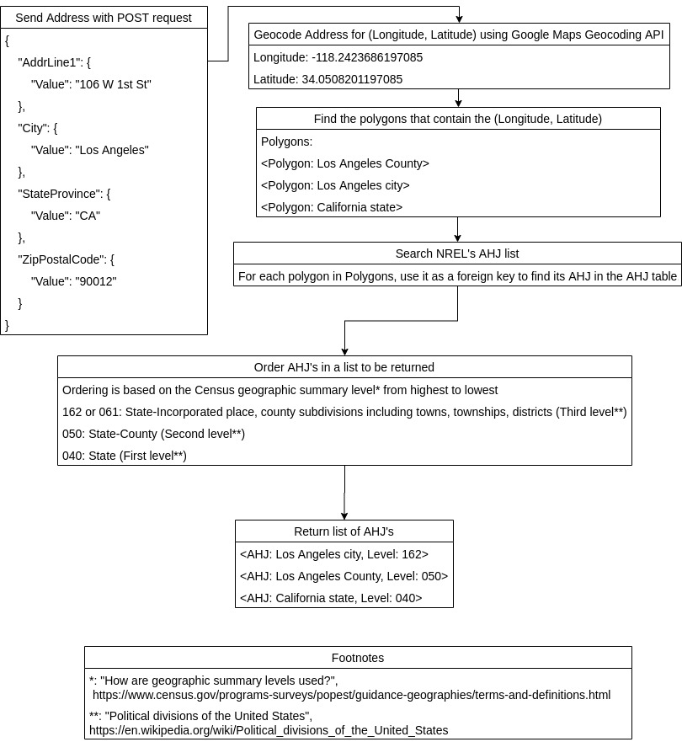
Address Search
Overview
Footnotes:
*: “How are geographic summary levels used?”,
https://www.census.gov/programs-surveys/popest/guidance-geographies/terms-and-definitions.html
**: “Political divisions of the United States”, https://en.wikipedia.org/wiki/Political_divisions_of_the_United_States

Slide 3
Where do the Polygons come from?
Currently, the AHJ Registry only has the polygons from the 2019 Census Bureau Counties (and equivalent) shapefile and Places shapefiles.
The List of States, Counties and Places (total: 33143) from the 2019 Census vs. NREL’s AHJ list (total: 43,096):
The AHJ Registry does not have a polygon for every AHJ in NREL’s list (missing polygons: 6,587).
NREL’s list does not have an AHJ for every polygon from the 2019 Census (missing AHJ’s: 10,848).

Slide 4
What to do about the Missing Polygons and AHJ’s?
Some of the missing polygons are in older Census Bureau shapefiles.
We could find the Census Bureau shapefiles contain the polygons, load them into the AHJ Registry, and record what year the polygons are from.
When searching AHJ’s with coordinates, we can indicate what shapefiles were used in finding each result.
For example, Petersburg Census Area in Alaska exists in the 2010 shapefiles. If a coordinate is contained in this area, we would return the AHJ for it and say it was found using 2010 shapefiles.
Have an map showing what counties don’t have known AHJ’s yet, and encourage users to find them.

Slide 5
Finding Polygons Containing the Address
The address is geocoded into longitude-latitude coordinates (a geo location) using Google Map’s Geocoding API. This geo location is a single point.
There are three functions to find polygons containing a point in GeoDjango:
Intersects: returns TRUE if there is at least one common point between the point and polygon.
Covers: returns TRUE if the point is inside the polygon (including the border)
Contains: returns TRUE if the point is inside the polygon (excluding the border)
More information: https://medium.com/@mentin/which-predicate-cb608b470471
According to the link above, Covers and Intersects should function identically when checking if a point is inside a polygon.

Slide 6
Finding Polygons Containing the Geo Location
When testing, Intersects and Covers gave different results.
For example, searching with the Geo Location ( Longitude: -120, Latitude: 37.5):
Intersects returns three counties: Mariposa, Madera, Fresno
Covers returns one county: Mariposa
Contains return one county: Mariposa
Mariposa is the correct county

Slide 7
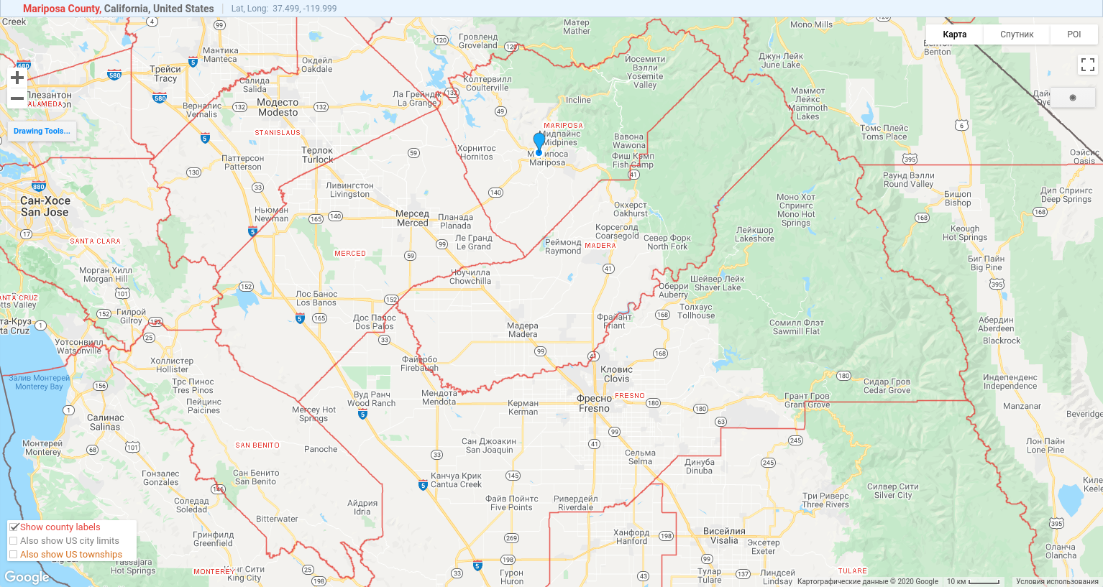
Finding Polygons Containing the Coordinate

Slide 8
Finding Polygons Containing the Coordinate
Which function does the AHJ Registry use?
For performance, it first runs Intersects to find a set of potential polygons.
Finally, it runs Covers to find the correct polygons in the potential polygon set.
Experience using these two:
If Covers returns TRUE, then Intersects returns TRUE. Therefore, Intersects will always include the correct polygons among its potential polygon set.
https://medium.com/@mentin/which-predicate-cb608b470471
Using only Covers is much slower.
Timing on local computer:
Using Intersects then Covers: 8-10 seconds - Using only Covers: 40-45 seconds

Slide 9
How the Returned list of AHJ’s are Ordered
Goal: Order the AHJ’s from third level political divisions to first level political divisions (political division levels: https://en.wikipedia.org/wiki/Political_divisions_of_the_United_States)
Census geographic summary levels map to the political divisions. (geographic summary levels: https://www.census.gov/programs-surveys/popest/guidance-geographies/terms-and-definitions.html) A geographical summary level is assigned to each AHJ as an AHJ Level Code.
The mapping of geographical summary levels used in the AHJ Registry:
162 or 061: State-Incorporated place, county subdivisions, towns, townships, districts (Third level political division)
050: County (Second level political division)
040: State (First level political division)
AHJ’s are returned in order from the third level to first level political division by sorting them from highest geographical summary level to lowest.

